Slide 1

Weekly Report
14.10.2021
Hikmat Shahi

Slide 2
Agenda this week
First iteration
Hikmat Shahi

Slide 3
Summary
Type of Load | Design Objectiv | Mass of the wing | Displacement | Percentage
Aerodynamik load (2g) | Min. Weight | 1.184 kg | 27,6 cm | 15,33 %
Aerodynamik load (2g) | Max. Displacement | 1,697 kg | 28,2 cm | 15,67%
Aerodynamik load (4g) | Min. Weight | 1,516 kg | 32,1 cm | 17,83%
Aerodynamik load (4g) | Max. Displacement | 1,697 kg | 32,4 cm | 18%
Hikmat Shahi

Slide 4
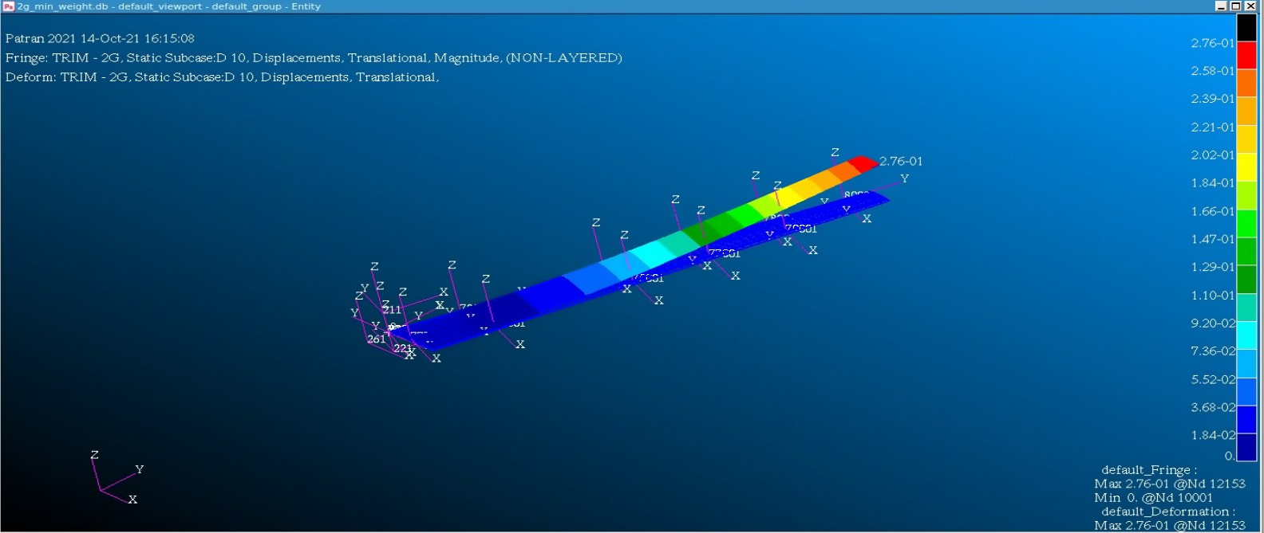
Mass : 1,184 kg
Hikmat Shahi

Slide 5
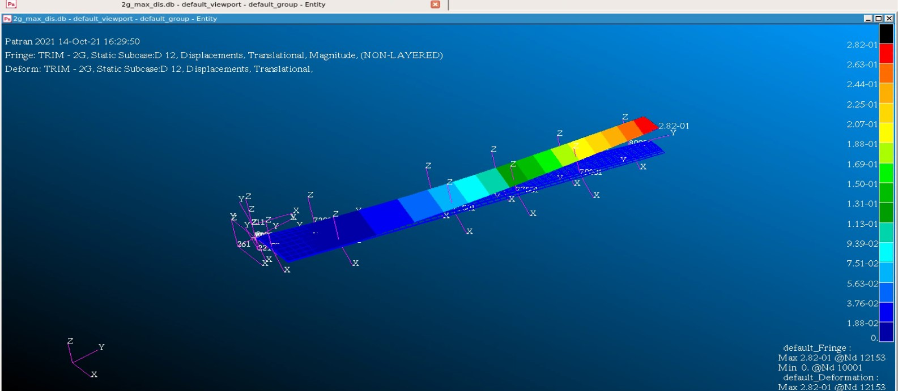
Mass : 1,697 kg
Hikmat Shahi

Slide 6
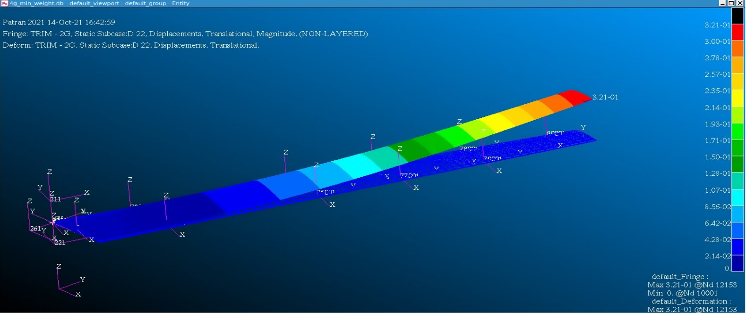
Mass : 1,516 kg
Hikmat Shahi

Slide 7
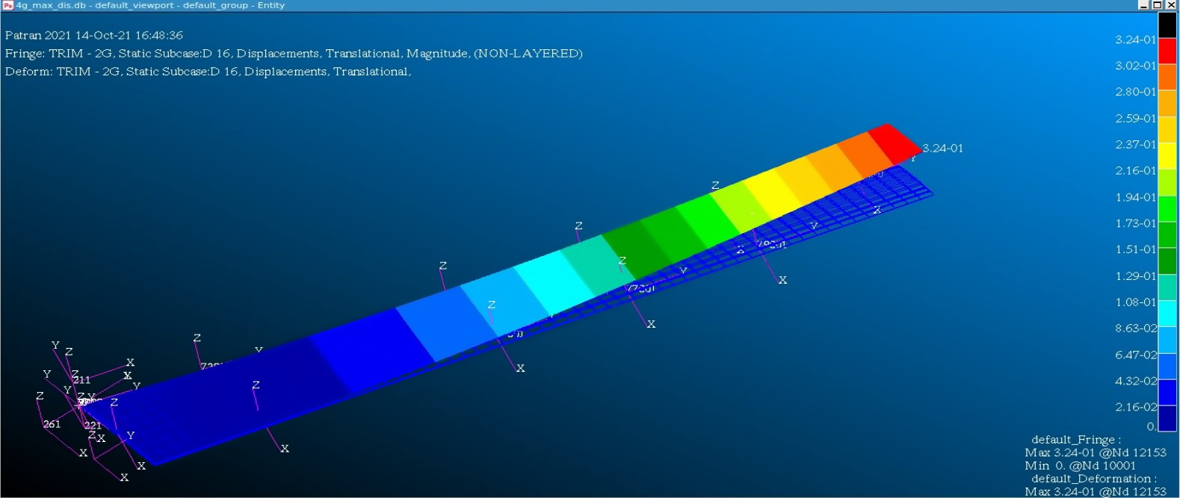
Mass : 1,697 kg
Hikmat Shahi

Slide 8
Next step
Script to collect the data from output file
Variation on model
Collect data for the evaluation of the model
Optimal Design
Hikmat Shahi

Slide 9
Thank you for your attention
Hikmat Shahi

